Slide 1

CureMD
Practice without boundaries
FUNDAMENTALS
OF
DENIALS MANAGEMENT
REVENUE CYCLE MANAGEMENT

Slide 2


01
What is Denial
05
Benefits of Correct Claim Processing
02
Denial Sources
06
Examples & Solutions
03
Denials Categories
07
Conclusion
04
Denial Management Process

Slide 3

WHAT IS DENIAL
Anything at a risk of write-off.
You are expected to get paid for it and you didn’t.
DENIAL MANAGEMENT
In a word, denial management is a strategic process that aims to unmask and resolve problems leading to medical claim denials. But that’s not all; the process should also mitigate the risk of future denials, ensuring that practices get paid faster and enjoy a healthy cash flow.

Slide 4

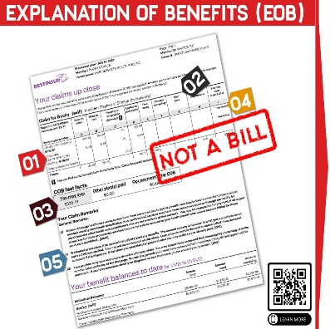

DENIAL SOURCES
ERA
EOB
FOLLOW-UP

Slide 5



DENIALS CATEGORIES
CLINICAL DENIALS
ADMINISTRATIVE DENIALS
Timely Filing
Inactive Coverage
Non Covered
CLIA
Medical Necessity
No Authorization
LCD/NDC
DRG Downgrade

Slide 6


DENIAL MANAGEMENT PROCESS
Denial Management Process
Identifying
the
Problem
Analyzing
Resubmit claims
Developing a
Tracking
Mechanism
Building a
Preventive
Mechanism
Monitoring
Future
Claims
We drill through the root cause for which the claim was denied.
Creating a second level check based on top denial reasons to avoid.
By Reason Code
By Payer
By CPT
Client Education
User Education
Payer Guidelines
System Enhancement
Timelines
Resubmit a corrected claim.
Send Appeal or dispute.
Send Supporting documents.
Tracking status of the resubmitted claim with regular follow-up.

Slide 7

COMMON DENIAL REASONS
No Referral or Preauthorization
Inconsistent Place of Service
Missing or Invalid Modifier
Invalid Patient Information
Invalid CPT or ICD Code
Coverage Terminated
Deductibles Not Met
Missing Information
Benefits Exceeded
Duplicate Claim
Untimely Filing
Non Covered
Bundling

Slide 8
BENEFITS OF MANAGING DENIALS
Increased Net Revenue Collection
Improved
Clean Claims
Rate
BENEFITS OF
DENIALS
MANAGEMENT
Enhanced
Patient
Experience
and
Loyalty
Build
Provider’s
Trust
Enhanced
Productivity
Improved
Billing
Accuracy

Slide 9
EXAMPLES
REASONS
Service Exclusion
Provider Not In-Network
Policy Limitations
Policy Changes
Non-Covered Benefits
NON COVERED SERVICES
Details of the non covered service, why the service is non covered.
Is it as per patient policy or provider’s contract.
If provider’s contract - Can we appeal.
If patient’s policy – Check if patient can be billed.

Slide 10

EXAMPLES
NO REFERRAL
Why they required referral.
Check other paid claims.
Check if there is any referral in the system.
Resubmit the corrected claim with referral.

Slide 11
EXAMPLES
CAPITATION
Home care Agencies
Inpatient
Care
Medicine
Specialists
Common
Diagnosis
CAPITATION
Claim process date.
When they paid capitation amount to provider.
If possible, date of capitation contract.
Confirm, is it based on patient or service.
In case of service. Confirm that the service is covered in the contract.

Slide 12
EXAMPLES
REASONS
Discrepancies in Eligibility
Incomplete or Inaccurate Information
Incorrect Sequence of Billing
Benefit Plan Changes
Non-Participation
COB
Check the paid examples.
Information of other insurance.
Check if we request patient to update his/her COB.
Check if patient can be billed.

Slide 13

EXAMPLES
UNTIMELY FILING
Check the date when we filed the claim.
Date on which insurance received the claim.
Verify timely filing limit.
Check the proof available.
Check if we send the appeal.

Slide 14

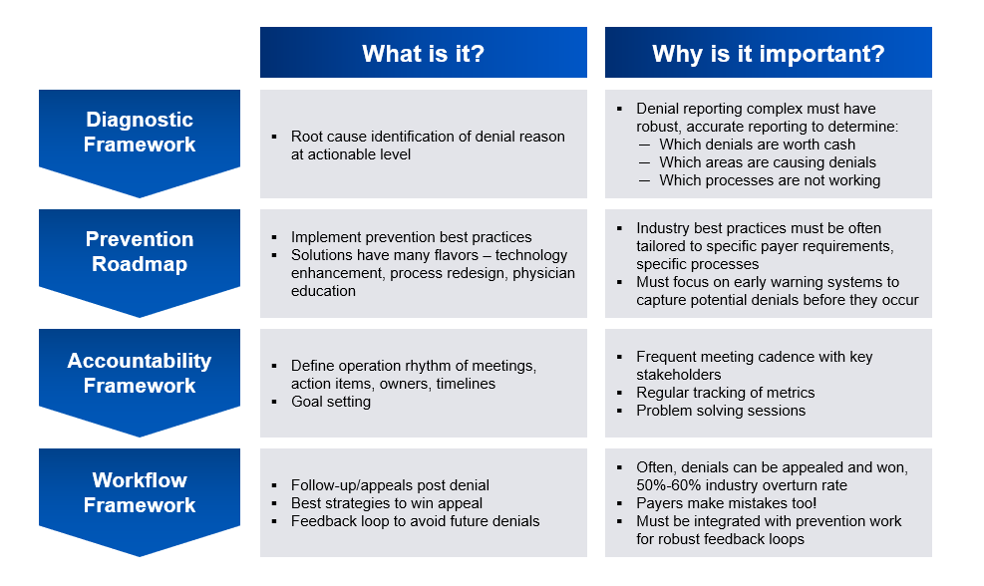

COMPREHENSIVE SOLUTIONS

Slide 15

Denials management is a crucial component of healthcare revenue cycle management. By effectively identifying, appealing, and preventing claim denials, healthcare providers can secure their financial health, ensure compliance with payer requirements, and maintain a positive reputation. It's an ongoing process that requires attention to detail, a commitment to continuous improvement, and a focus on optimizing revenue and cash flow. Ultimately, successful denials management contributes to the overall financial stability and success of healthcare organizations.

Slide 16




CureMD
Thank you for Staying with us.
Waqas Akram.
+1 347-732-1370
Waqas.akram@cueremd.com
80 Pine Street, 21st Floor New York, NY 10005

